Slide 1

Analysis of Revenue and Order Data
Vinod Fartyal

Slide 2

Overview of Revenue and Order Metrics

Slide 3

Total Revenue And Order Summary
Revenue Performance Overview
Total revenue of Rs.71,789,040 indicates strong market presence and effective sales strategies, essential for assessing business growth and sustainability.
Order Volume Insights
The total order volume of 128,949 highlights strong customer engagement, yet the 14.23% cancellation rate, translating to 18,341 cancellations, suggests significant room for improvement. This cancellation rate not only indicates potential revenue loss but also points to areas within the customer experience and operational processes that may need attention.

Slide 4
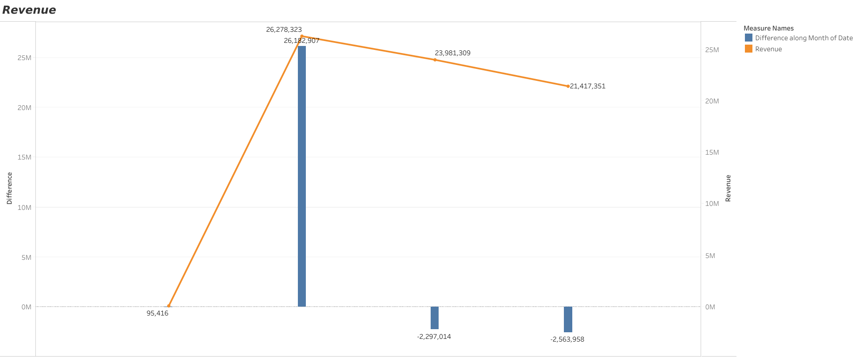
Monthly Revenue Breakdown
Revenue Fluctuation Analysis
The significant revenue drop in May and June underscores the need for a comprehensive review of market conditions and operational strategies to prevent future declines and enhance overall revenue stability.

Slide 5


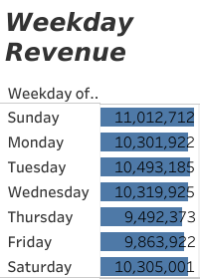
Weekday Revenue Insights
Revenue Performance Trend
Analyzing weekday revenue reveals a consistent pattern of higher sales on weekends, indicating a need for strategic initiatives to boost weekday engagement and sales performance.

Slide 6
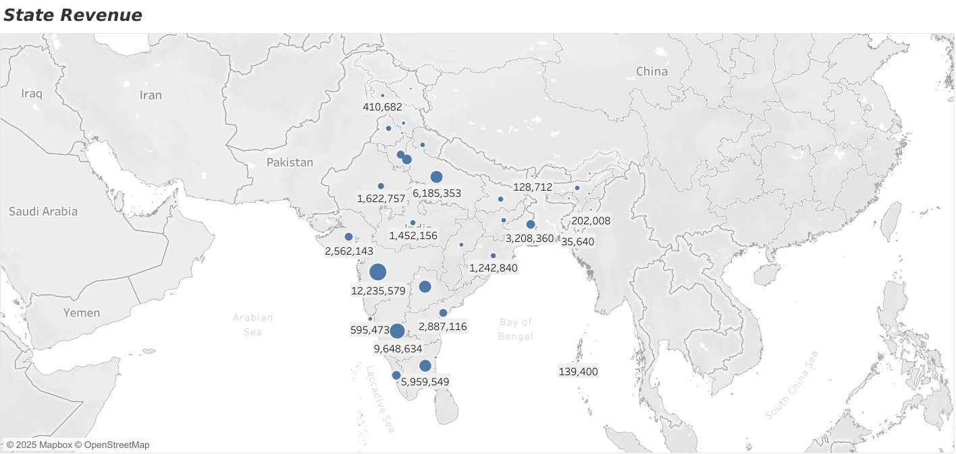
Revenue by State Analysis
State Performance Perspectives
With Maharashtra leading, the market's strengths are highlighted by detailed revenue contributions, suggesting the possibility of focused growth plans in high-performing areas.
Trends in Consumer Behavior
Diverse customer tastes and economic circumstances are reflected in revenue variations, which calls for customized marketing strategies to increase participation in each state.
Opportunities for Strategic Growth
Finding underperforming states, like Telangana Uttar Pradesh, might help direct targeted efforts, including regional product offerings and promotions, to increase overall income.

Slide 7
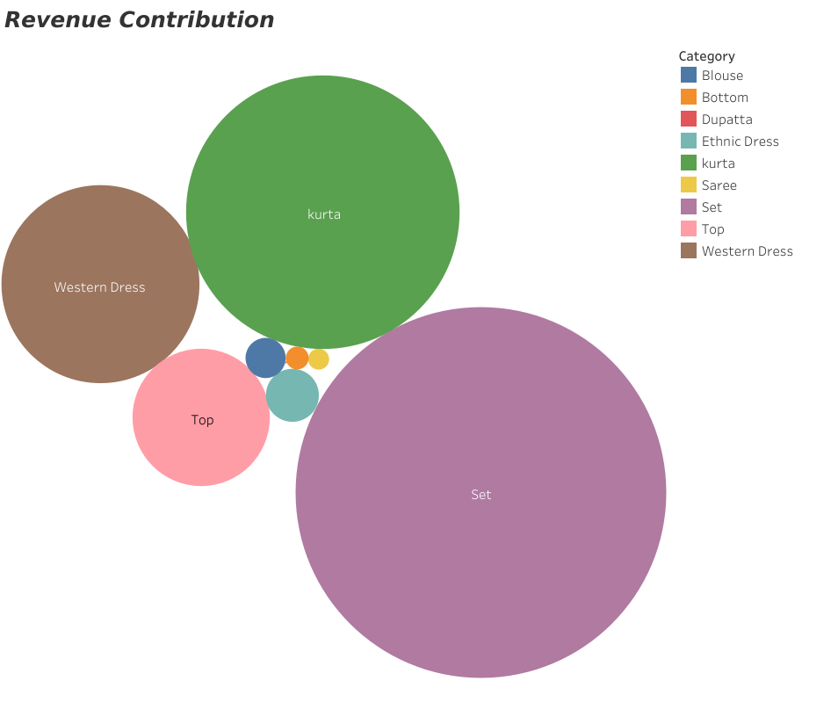
Revenue Contribution by Product Category
Key Revenue Drivers
Western Dresses and Set wear categories significantly influence
overall sales, reflecting consumer preferences for versatile and
culturally relevant attire, necessitating focused marketing strategies.

Slide 8
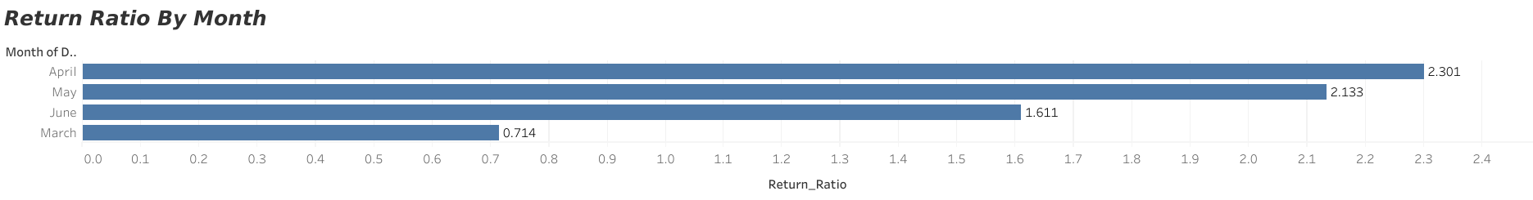
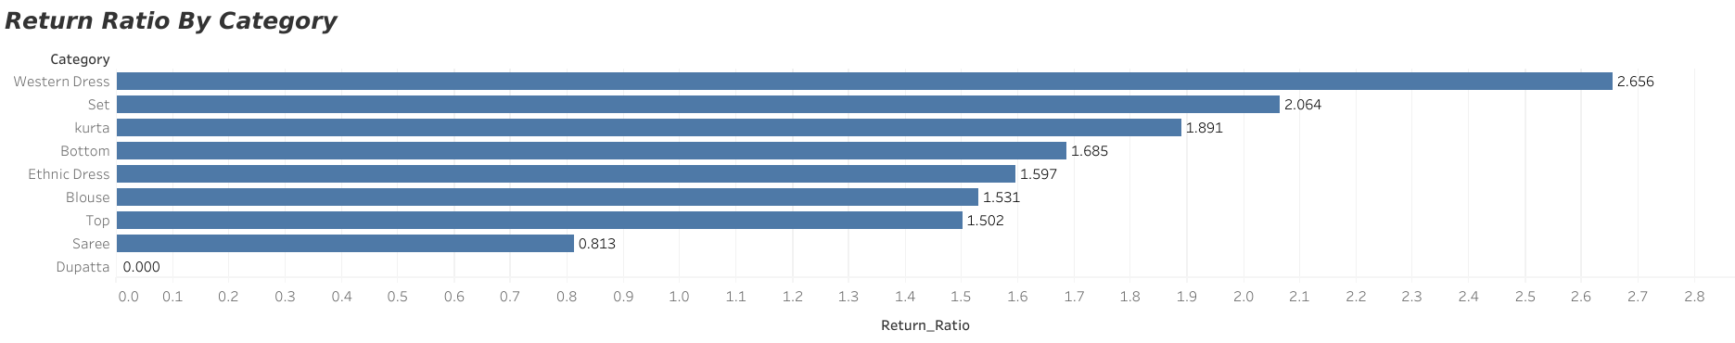
Return Ratio
Return Rate Analysis
The Largest Return Rate for Western Dress Indicates possible quality problems that need to be addressed right away, while the maximum return ratio for months is April.

Slide 9
Conclusions and Strategic Recommendations

Slide 10

Key Findings from the Analysis
Revenue Performance Insights
Monthly Revenue Volatility
The analysis reveals a total revenue of Rs 71,789,040 from 128,949 orders, highlighting strong sales but also indicating a need to address the 18,341 cancellations affecting overall performance.
Significant fluctuations in monthly revenue, particularly the anomalous drop in May, suggest the necessity for strategic interventions to stabilize income and enhance operational effectiveness.

Slide 11

Suggested Actions for Revenue Growth
Focus on High-Revenue Categories
Reduce Returns
Continue to promote and expand offerings in the "Set," "Kurta," and "Western Dress" categories.
Prioritize marketing efforts and product innovation in these categories to maximize revenue potential.
Leverage customer insights and trends to introduce new designs and styles that align with market demand.
Enhance product descriptions, sizing guides, and images to provide customers with clearer expectations.
Improve customer support to assist shoppers in making informed purchasing decisions.

Slide 12

Geographic Market Expansion and Sales Optimization
Strategic Inventory Management
Sales data indicate that Maharashtra, Karnataka, and Delhi are high-performing regions, justifying focused marketing and supply chain optimization.
Geo-targeted advertising and influencer collaborations can drive higher brand resonance in these areas.
Logistics performance assessments recommend streamlining distribution channels to ensure faster deliveries and reduced operational costs.
Demand forecasting models indicate that "Set" remains a high-demand category, requiring optimized inventory management.
Predictive analytics should be leveraged for real-time demand sensing and agile inventory adjustments.
Strengthening supplier collaboration and implementing advanced inventory tracking technologies will enhance supply chain resilience.

Slide 13

Recommendations for Revenue Improvement
Expand and Innovate High-Revenue Categories Based on Data-driven customer insights and trends analysis.
Mitigate Return Rates by refining product descriptions, sizing accuracy and enhancing customer support.
Strengthen Sales in Key Regions through geo-targeted marketing and optimized distribution strategies.
Optimize Inventory Management by integrating predictive analytics and fostering supplier agility.

Slide 14
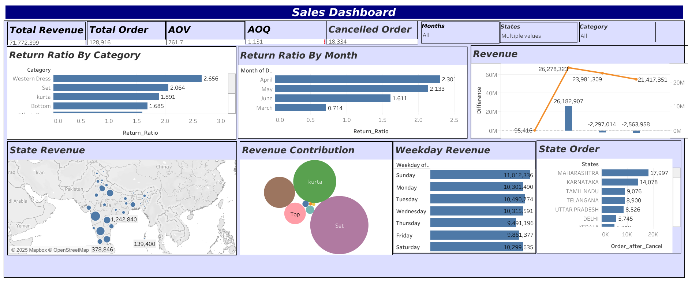
Dashboard

Slide 15

Thank You

